Slide 1

BANK ANALYTICS PRESENTED BY GROUP - 5
YOGESH NIMBAL
KRISHNA DHARMIK DHAMECHA
MRUNALINI JAYASINGH
MANOJ L
MONIKA.LADDHA
SINDHUJA SRIRAMULA
RAMEGOWDA R S

Slide 2
PROJECT OVERVIEW
The aim of this data analytics project is to analyze customer bank loan data to uncover patterns, trends, and insights that can assist in improving loan portfolio management, risk assessment, and customer targeting strategies. The project focuses on key performance indicators (KPIs) that provide a detailed understanding of loan behaviors across different segments.
To effectively visualize and interpret the data, we created interactive dashboards using the following tools: Excel, Tableau, and Power BI . These dashboards allowed for a dynamic and detailed exploration of the data, providing actionable insights that can be easily communicated to stakeholders.

Slide 3



OUR MODULES
EXCEL
Excel was used for initial data exploration, including calculating summary statistics like averages, totals, and distributions.
Pivot tables and charts in Excel were employed to create quick visualizations of year-wise loan amounts and other KPIs.
MYSQL
SQL was used to query the bank's database and extract relevant loan data for analysis.
Complex queries were written to filter, join, and aggregate data from multiple tables.
Data was cleaned and structured in SQL to ensure it was ready for further analysis in other tools
TABLEAU
A data visualization tool used for creating advanced visualizations and interactive dashboards.
Tableau's ability to create interactive visualizations helped in exploring the data more comprehensively and identifying hidden patterns
Power BI
Power BI was used to develop interactive reports and dashboards.
The tool’s capabilities in handling large datasets and creating dynamic visuals.
Power BI's integration features allowed for combining data from various sources, enhancing the overall analysis

Slide 4
KPI’S USED
KPI-1: Year wise loan amount Stats. KPI-2: Grade and sub grade wise revol_bal.
KPI-3: Total Payment for Verified Status Vs Total Payment for Non Verified Status.
KPI-4: State wise and last_credit_pull_d wise loan status.
KPI-5: Home ownership Vs last payment date stats.

Slide 5
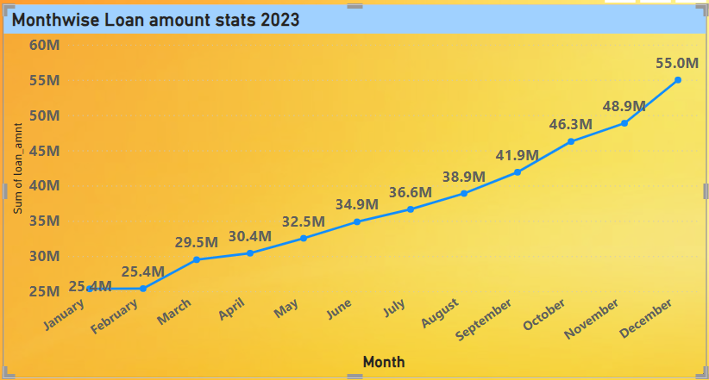
KPI-1 MONTH WISE LOAN AMOUNT STATS.
A line graph that shows the **Month-wise Loan Amount Statistics for theMonth Jan to Dec. The graph illustrates the sum of loan amounts issued each month.
Trend: The graph shows a clear upward trend, with loan amounts growing exponentially each month.
Growth: The most significant growth occurred between Jan to Month, indicating a rapid expansion in the loan portfolio during these years.

Slide 6
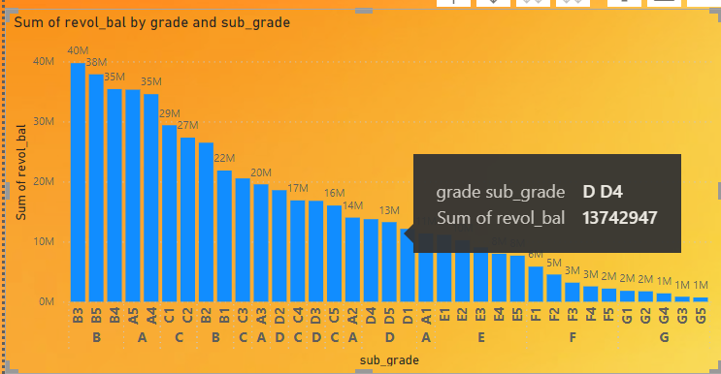
KPI-2 GRADE AND SUB GRADE WISE REVOL_BAL.
The bar chart "Grade and sub grade wise revol_bal." It visualizes the sum of "revol_bal" (which likely refers to revolving balance, such as outstanding credit card balances) for various grades and subgrades.
Subgrades in grade B (B3, B5) have the highest revolving balances, with B3 having the highest ($40 M).
- The revolving balances decrease as we move from grade A to G, with subgrades in grade G having the lowest balances.- Grade G subgrades have significantly lower revolving balances compared to other grades.

Slide 7
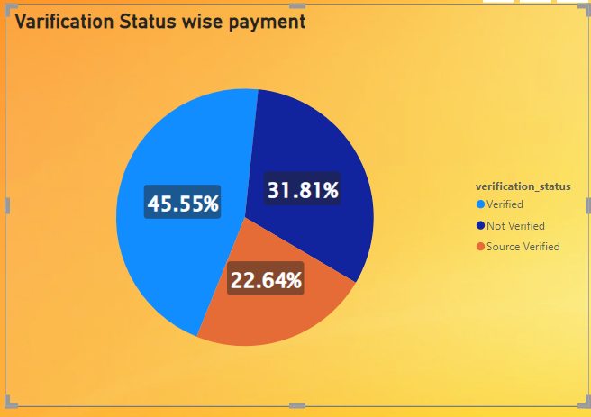
KPI-3 TOTAL PAYMENT FOR VERIFIED STATUS VS TOTAL PAYMENT FOR NON VERIFIED STATUS.
The chart illustrates the distribution of total payments made by customers based on whether their status was verified or not. The larger portion of total payments, 58.88%, comes from customers whose status was verified. This suggests that verified customers are more likely to make higher or more consistent payments compared to non-verified customers. Non-verified customers still contribute a substantial 41.12% to the total payments, indicating that even without verification, a large portion of customers are fulfilling their payment.

Slide 8
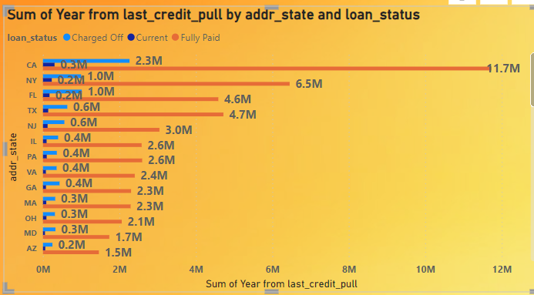
KPI-4 STATE WISE AND LAST_CREDIT_PULL_D WISE LOAN STATUS.
This line graph showing the State-wise and Last Credit Pull Date-wise Loan Status. The graph plots the number of loans across different states in the U.S. based on their loan status, which includes "Charged Off," "Current," and "Fully Paid". Some states, like California (CA) and New York (NY), show a higher number of loans. In most states, there is a relatively balanced distribution between loans that are "Current" and "Fully Paid," with fewer loans being "Charged Off."

Slide 9
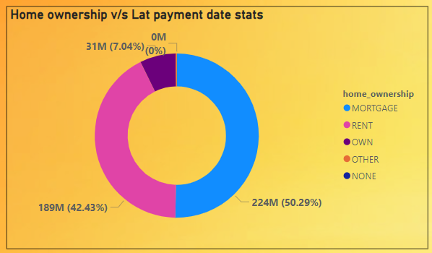
KPI-5 HOME OWNERSHIP VS LAST PAYMENT DATE STATS.
This is a Donut chart that visualizes the relationship between different types of home ownership and the last payment date. The chart shows the percentage distribution of these home ownership types.
This indicates that 50% of the last payment dates correspond to individuals with a mortgage, with 42% who are renting their home, 7% who own their homes outright.

Slide 10
DASHBOARDS

Slide 11
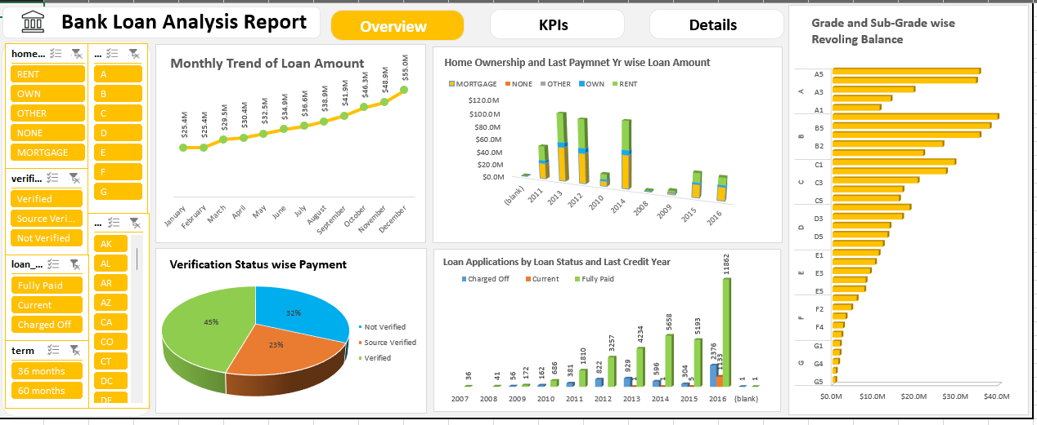
EXCEL DASHBOARD (Bank Analytics)

Slide 12
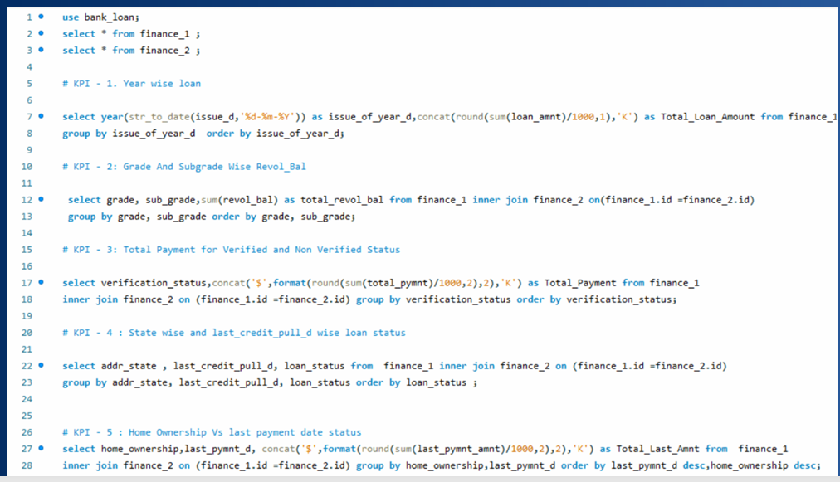
MYSQL QUERIES

Slide 13
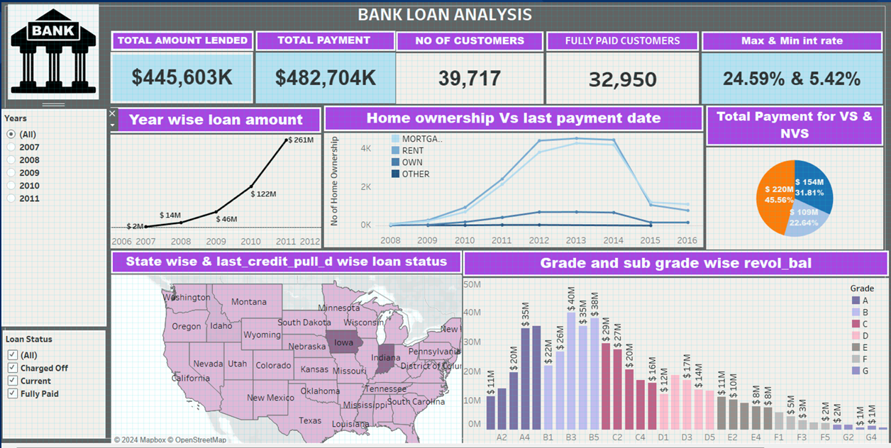
TABLEAU DASHBOARD

Slide 14
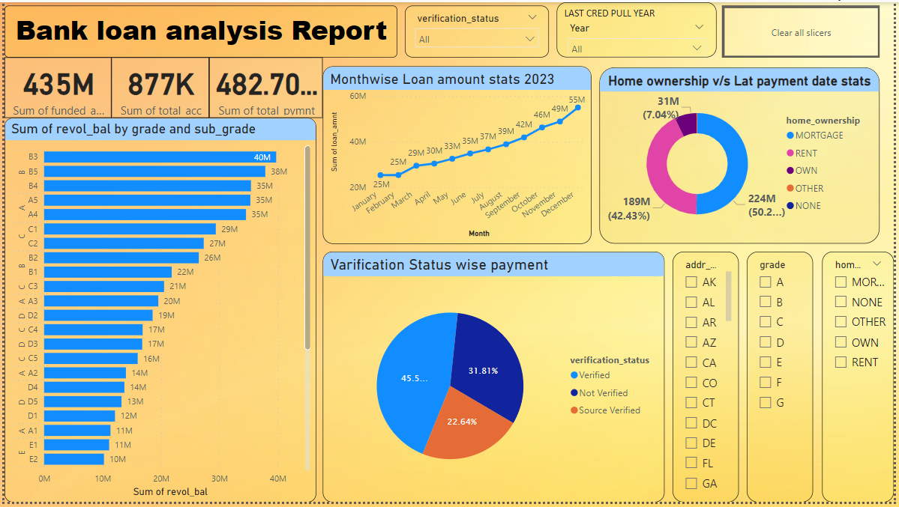
POWER BI DASHBOARD

Slide 15

CONCLUSION
The project has successfully covered significant trends and patterns in the bank's loan portfolio, offering actionable insights that can be used to refine lending strategies, enhance risk management, and improve customer targeting. The use of tools like Excel, Tableau, Power BI, and SQL was critical in preparing comprehensive dashboards that facilitate informed decision-making.

Slide 16


